Slide 1
INFSCI 0010
Introduction

Slide 2
INFSCI 0010
Survey the class
Review the syllabus
Overview of the BSIS Program
See slideshow on Information Science professional.
Questions/Answers

Slide 3
Objectives
1. Describe the Information Science Field and some of the available jobs
2. Explain and demonstrate some key concepts for driving interface design.
3. Specifically, address images and what makes them good and enticing.

Slide 4
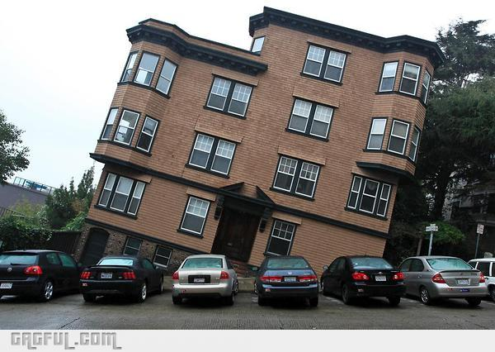
Curriculum Pathway
The Core – Build A Foundation
Introduction to Info Systems
JAVA Programming
Human Factors
Intro to Networking
Systems Analysis
Database ( Oracle)

Slide 5
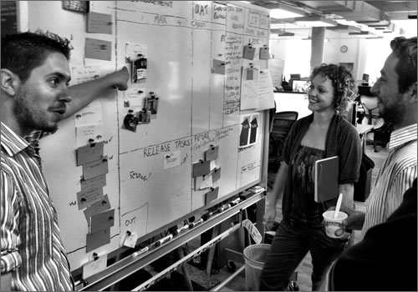


Get Focused
Concentrations – 3 courses
Information Systems
User Centered Design
Networks and Security
Self Design

Slide 6
Curriculum Concentrations
Information systems specialization:
object-oriented design tools
design, build, implement Web-based information systems.
User-centered design specialization:
visual and human-computer interaction skills
design and build prototypes of information interfaces
usability testing of systems.
Networks and security specialization:
design, build, and test LANS, WANS, Wireless, Internet, and Web-based networks.
Self Design:
flexibility to choose courses

Slide 7

Put It All Together
Capstone Experience
Internship or capstone course or independent study
Real World
Core
Teamwork
Concentration

Slide 8
Curriculum Strengths
Problem Based * Innovative * Cooperative * Faculty Support
Most courses require teamwork and real-life examples – Case studies from companies
Mazda – Business School collaboration
http://sis-teach-01.sis.pitt.edu/archive/mazda/
Mobile Start-Up Company
http://ceagent.com/
AthleteTrax – Start-up
https://www.athlete-trax.com/
Courses like INFSCI 1024, 1052, 1059, and 1025 require real life projects
SIS has unique project based independent study series.
Google Glass Project

Slide 9
Curriculum Electives
Computer Security Network Security
User Centered Design
Graphics
IT Management
Design of Information Systems
Data Analytics Visualization Geographic Information Systems
Internships Independent Study Capstone experiences
Application of Networks
Wireless Networks
Comp Networking Lab

Slide 10
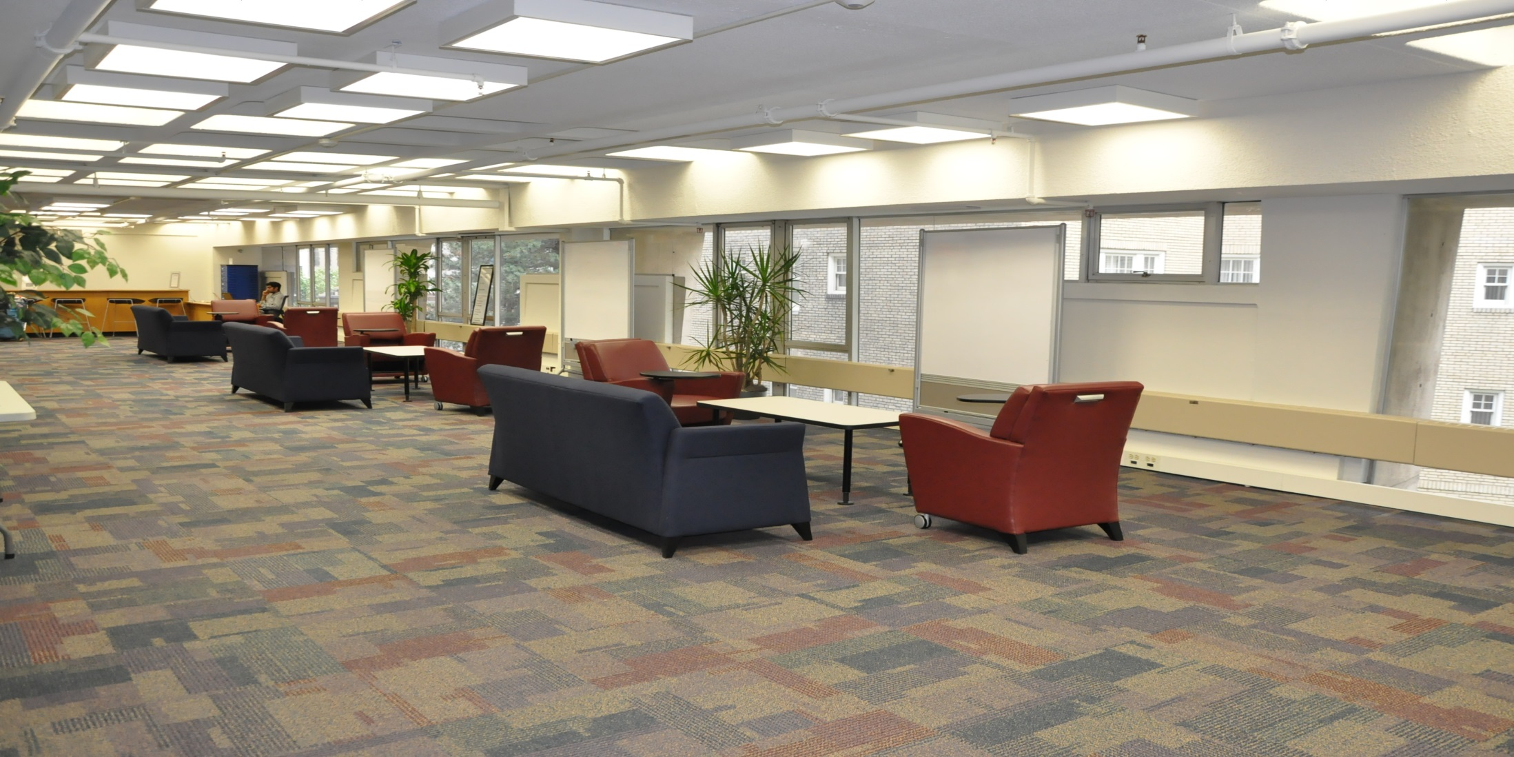
CO-LAB Center

Slide 11
Student Achievement
94% Placement Rate – Average Salary in mid 50’s
Companies hiring Information Science graduates
Job Titles –
Let's Go Live – LinkedIN – http://www.linkedin.com – perks@pitt.edu longpass+#
PPG | IBM
DelMonte | Oracle
UPMC | BONY
Alcoa | Deloitte
Systems Analyst | Business Analyst | Network Analyst
Interface Design | App Developer | DB Manager

Slide 12
Fun Facts
Deloitte Case Competition
Entrepreneurship
Coaching
Student Driven and Faculty Led Projects
Organizations like UPMC and Medical/Dental/Pharmacy Schools
TEC Conference
I-Fest
Studio
Videos

Slide 13
Interface Project
Music Video Download System
Break into small groups
Best to exchange contact info and choose a leader
You will build the interface (prototype) for a music download system
Theme
Target Audience
Colors
Icons or Pictures
Use whatever drawing/design program
Most people use PowerPoint

Slide 14
Interface Project
Be creative
Castle Project
World/Globe
You can be traditional also with some things like controls
Most important is your target audience and an interface that is engaging!!!
You must give it a name
Is it free or how would you charge?

Slide 15
Interface Project
We will meet once more in class as a group to discuss the project. It is up to you to meet, review, prototype your design outside of class.
Recommend either email, Google Docs or some other group management software.
Each group will choose a leader and that person will submit on behalf of everyone.
In the assignment listing in CourseWeb there is a checklist for the homework

Slide 16
Interface Project Team
Chose a leader – volunteer or vote
Assign duties based on skill sets:
PowerPoint Expert ??
Artist - Color ideas
Theme and functions – everyone contributes
Writing – who are the good writers ??
Leader needs to manage, coordinate and meet the submission deadline

Slide 17
Interface Project Team
Group Collaboration Software
You can physically meet
You can use email or messaging
You can use groups on social media
You can use Google Drive or Docs
https://www.youtube.com/watch?v=CeFJvXhFJd8

Slide 18
Interface Guidelines
Design Thinking
Creative
http://www.ted.com/talks/tom_wujec_build_a_tower
Iterative – key to many design and programming efforts
Top three skills needed to work in a team ?
Metaphors – Desktop Others?

Slide 19
Interface Design
Ease of Use – primary
Tips on design
Some bad design
http://thenextweb.com/dd/2015/09/29/6-examples-of-awful-ux-design/#gref

Slide 20
Interface Ideas
Do I need to be an artist?
Don't miss the obvious
http://www.hongkiat.com/blog/ted-video-for-web-designers/
Some questions
What makes a car sizzle?
What makes a home comfy?
What makes a smart phone cool?
What makes a clothing outfit hip?

Slide 21
Interface Design
Mental Models
How things work in the real world
Mail, driving a car, reading a newspaper
CNN website versus Amazon versus NetFlix
What mental models are being accessed?
Color
http://www.colorpicker.com/c390d4
http://htmlcolorcodes.com/color-picker/
https://color.adobe.com/explore/newest/
Powerpoint ->Format ->ShapeFill –More Colors
RGB: Red Green Blue Values

Slide 22
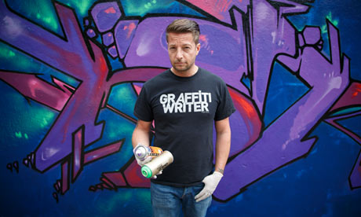
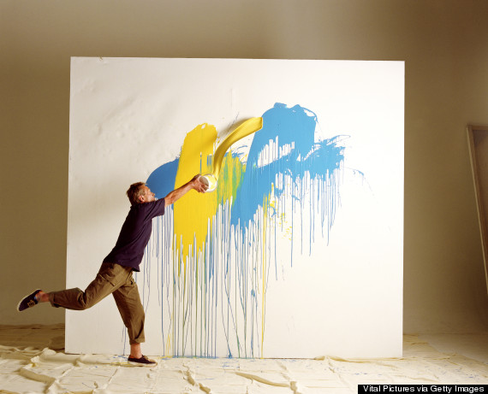
Interface Design
Lets talk about images:
See images slideshow

Slide 23

Images
“Users pay close attention to photos and other images that contain relevant information, but ignore fluffy pictures used to “jazz up” webpages.” - Jakob Nielsen.
Ad on left 6% of people looked at the product area. On right 84% looked at product. What’s different?
http://www.1stwebdesigner.com/design/images-on-web-design-usability-guide/

Slide 24
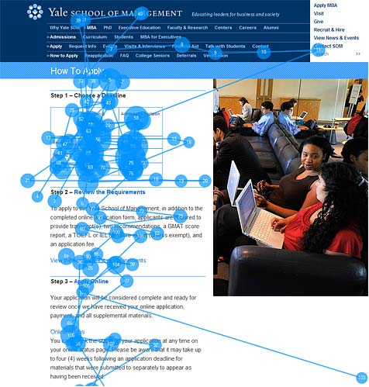
Images
Study by the Nielsen Norman Group showing how people ignore stock images of generic people having little to do with the topic. http://www.nngroup.com/articles/photos-as-web-content/

Slide 25
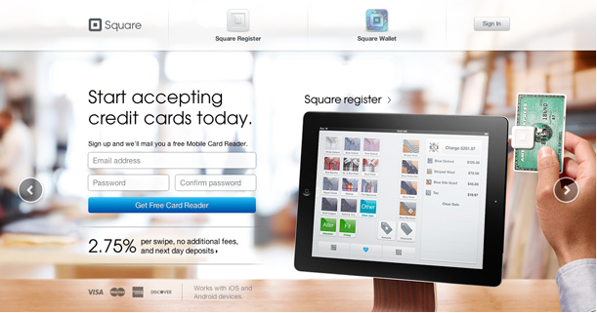
Images
One picture tells you: how the card reader attaches to the device, How big it is, what device it works with, how to swipe credit card, what appears on the screen VS writing many paragraphs.

Slide 26

Images
What words come to mind?

Slide 27

Images
Stock photos/
Avoid clichéd, overused images and ideas and make sure the people look real.
Are they realistic? Do your clients look like models or mannequins?

Slide 28

Images
Beware of subjects smiling at the camera.

Slide 29
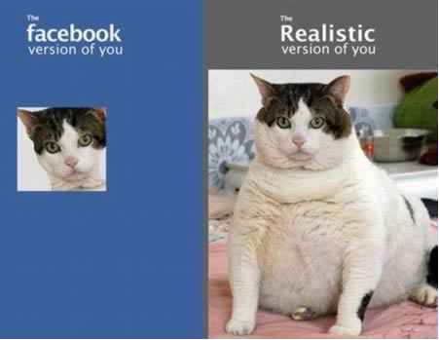
Images
Crop images but don’t lose what is important
Cropping Tutorial: http://digital-photography-school.com/cropping-for-impact

Slide 30
Images
Make sure the photos are crisp and not fuzzy or out of focus. – DON”T DISTORT!
Distortion looks ridiculous.

Slide 31
Images
Do basic photo editing to clean up red eye and brighten/darken if necessary
Don’t use super large images or super small images
Don’t use a distorted super large background image. This is really ugly!
Size and crop outside of your browser in Photoshop or similar image editing software. Let the server do the work not the client. Lessen bandwidth.
Pay attention to consistency of size of images – not all should be different sizes unless intentional for effect.

Slide 32
Images
Keep the resolution low for faster loading http://httparchive.org/interesting.php?a=All&l=Jan%201%202014&s=All
According to data from January 13, 2014: 61% of a webpage is filled with images, with the average size of a webpage being 1.29 MB. See above link for other stats.
Use Photoshop Save for Web and devices – experiment with different quality levels – choose 75% over 95% if the quality meets your needs. Rarely if ever would you use 100%
Start with pictures with good resolutions

Slide 33
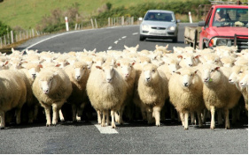
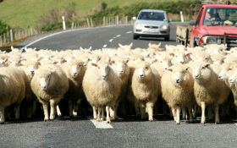
Images
One of the images is at 95% and the other at 80%. Can you tell?

Slide 34
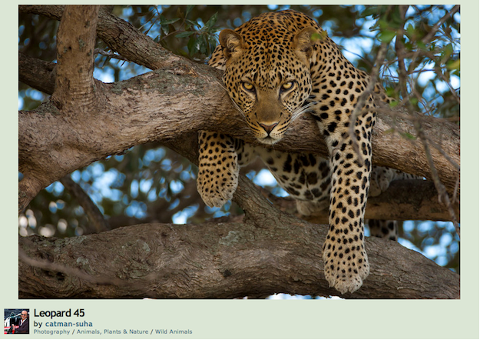
Images
This doesn’t have to do with anything I am saying. It’s just compelling! Not rules for everything!

Slide 35
Images
Joint Photographic Experts Group – the committee that wrote the standard
Good for photographs, naturalistic artwork and color transitions – not good for line drawings or lettering (typography)
Supports up to 16.7 million colors
Lossy

Slide 36
Images
GIF
Graphics Interchange Format
Lossless
Good for broad, flat solid colors, grayscales and for animation – not with gradients
Good for simple logos, line drawings, icons or symbols.(typography)
Limited to 256 colors – 8 bit

Slide 37
Images
PNG – 8 – 24 – 32bit
Portable Network Graphics
Good for transparency and computer generated images such as charts – not PNG 8
Lossless
Does not support animation

Slide 38
Images
Where do I find images? http://john.do/images/
Paid
Istockphoto
Shutterstock
Getty Images
Free
Google search – be careful of copyright issues here
stock.xchng
morgueFile
License
CompFight – Flickr search tool or Flickr itself
A good tutorial on using search tools to find images on Flickr and elsewhere: http://amylynnandrews.com/using-images/

